Slide 1
“Light Model” Experiments = 10,000 Learning rate = 10 ** -4 layers = 4 epochs = 20 batch size = 2 ** 8 neurons = 2 ** 8
“Heavy Model”
Experiments = 10,000 Learning rate = 10 ** -4
layers = 4 epochs = 40 batch size = 2 ** 8 neurons = 2 ** 10

Slide 2
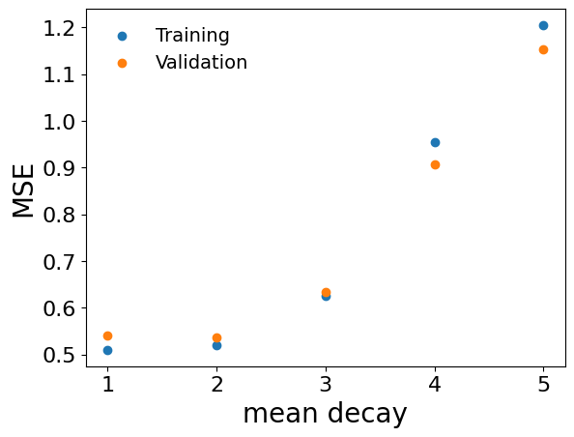
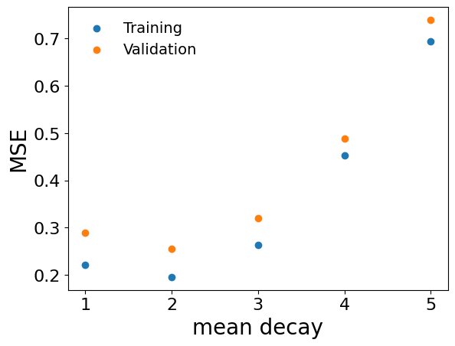
Qubits_2_TS_10_Shots_1000

Slide 3
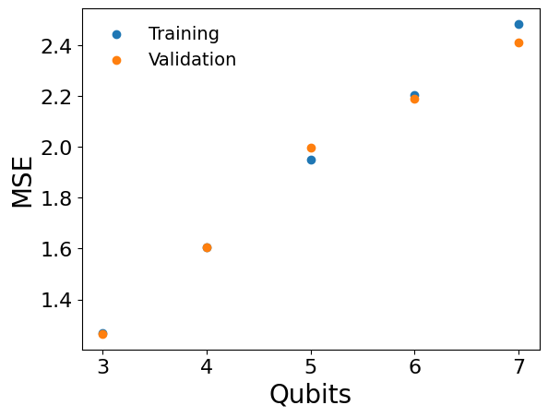
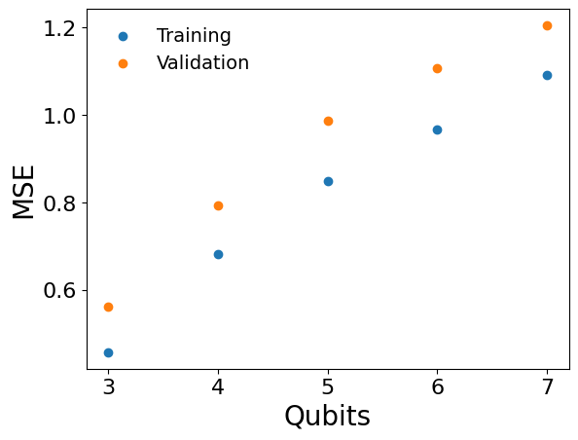
TS_10_Shots_1000_MeanDecay_3

Slide 4
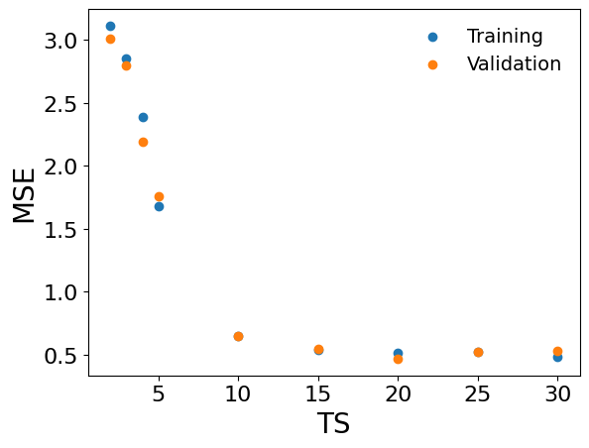
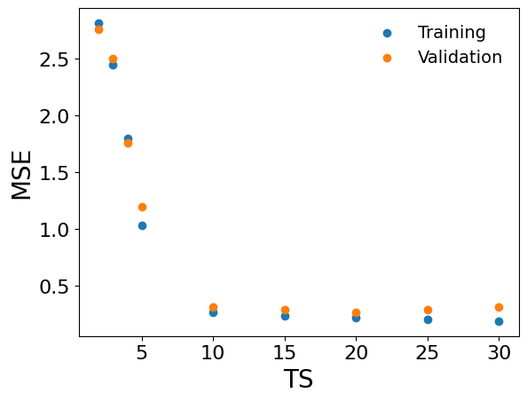
Qubits_2_MeanDecay_3 shoots*TS = 10,000

Slide 5
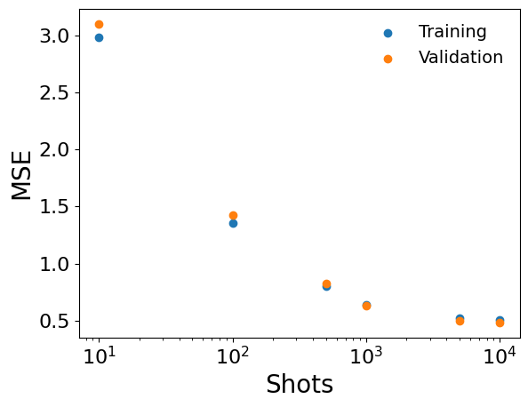
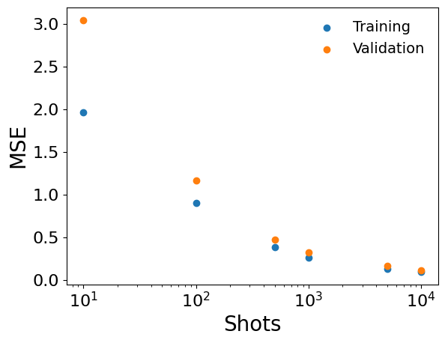
Qubits_2_TS_10_MeanDecay_3

Slide 6
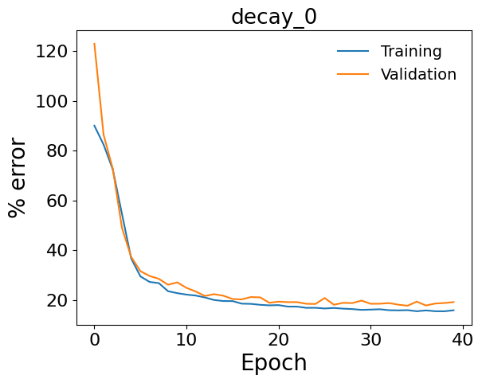
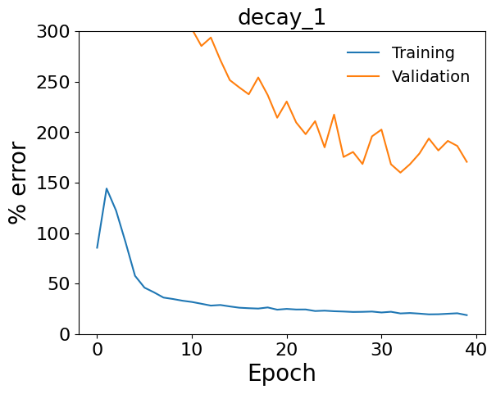
Qubits_2_Lines_10000_TS_10_Shots_1000_MeanDecay_3

Slide 7
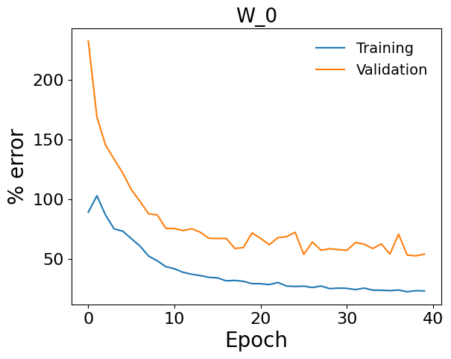
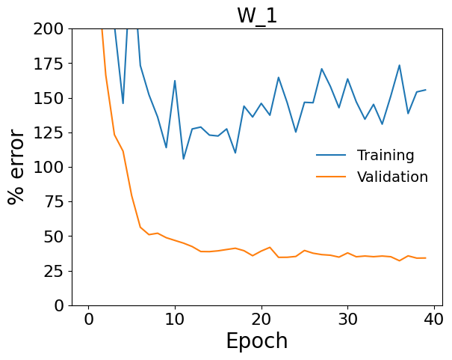
Qubits_2_Lines_10000_TS_10_Shots_1000_MeanDecay_3

Slide 8
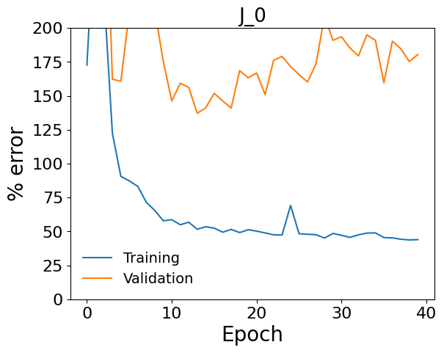
Qubits_2_Lines_10000_TS_10_Shots_1000_MeanDecay_3

